Slide 1


EndNote User Manual Pre
EndNote用户手册
The world’s best reference manager
汇报人：Group1

Slide 2

Why we
choose EndNote
Article Writing & Design
02
04
Start
End
01
03
05
07
Introduction
Why 4 parts in
our user manual
Summary
2

Slide 3
PART 01
Introduction

Slide 4
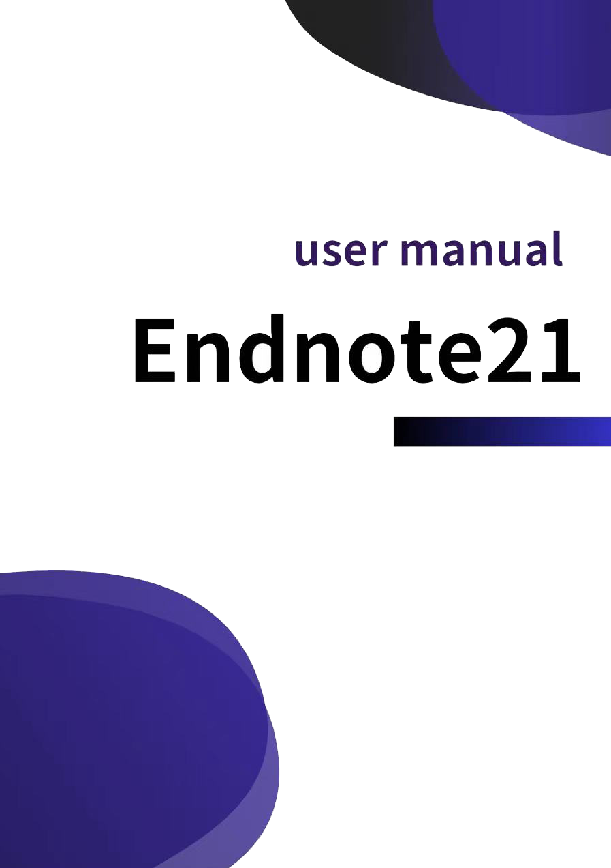
235234 侯宇捷
Design Concept
User-friendly
Comprehensive
Concise
Short Text Here
点击添加标题点击添加标题点击添加标题点击添加标题, 点击添加标题点击添加标题点击添加标题点击添加标题 点击添加标题点击添加标题点击添加标题点击添加标题nibh lacus laoreet turpis, quis

Slide 5







235234 侯宇捷
Allocation
孙利峰
窦艺初
Short Text Here
李婷婷
点击添加标题点击添加标题点击添加标题点击添加标题, 点击添加标题点击添加标题点击添加标题点击添加标题 点击添加标题点击添加标题点击添加标题点击添加标题nibh lacus laoreet turpis, quis
Group leader
Document：Improvements
Presentation：Sixth part
Group Member
Document：Literature Citation
Presentation：Fifth part
Extra work：Polish document
Group Member
Document：Introduction
Presentation：fourth part
Extra work： Polish document
金子昂
侯宇捷
韩永欣
陈巍炜
Group Member
Document：Literature
Management
Presentation：seventh part
Extra work： Integrate PPT
Group Member
Document：Features
Presentation：first part
Group Member
Document： Literature
Sharing
Presentation：third part
Group Member
Document：Literature
Collection
Presentation：second
part

Slide 6
PART 02
Why 4 parts in
our user manual

Slide 7

235232陈巍炜
Introduction
To let users have a general understanding of some of the basic information about EndNote and the features it supports
How to use it
To guide users on how to use the functions of EndNote, which enables users to learn efficiently and avoid making mistakes
Features
To point out the features of EndNote to let users know why they choose EndNote rather than some other similar products
Improvements
To not only give the developers ideas for further improvements, but also inform users of the shortage of EndNote

Slide 8
235232陈巍炜
When users read literatures, they usually need to search, manage, cite and share references. It is EndNote that just provides these four functions, so our user manual divides How to use it into such parts, which gives users a clear process of literature management as well as detailed guidance. And of course this part is the focus of our user manual
Reference Collection
Reference Management
Reference Citation
Reference Sharing

Slide 9
235236 韩永欣
1. Literature Collection
2. Literature Management
3. Literature Citation
4. Literature Sharing
4 main functions
Notes:
Our team carefully selected four main functions that serve as the foundation of the Endnote's functionality and utility. These functions are designed to help users understand the basic methods of using EndNote during their academic research. Now I will explain why we selected these four functions as part of the "How to Use EndNote" section.

Slide 10
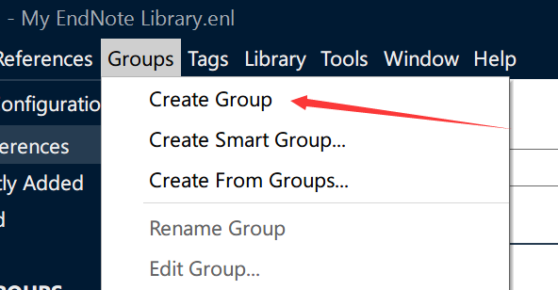
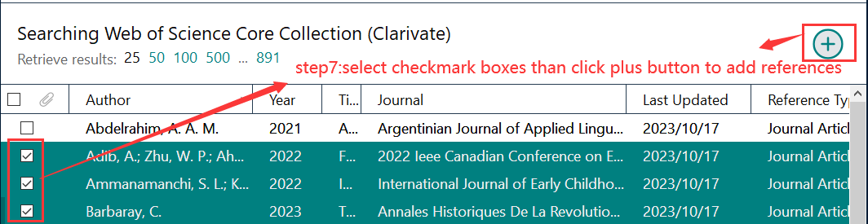
235236 韩永欣
1. Literature Collection
2. Literature Management
A repository of literatures
The most basic function
The need to manage literatures after collected
Facilitate literature retrieval
Notes:
Literature Collection: This section was included to highlight the critical aspect of building a repository of Literatures. Literature collection is the most basic function of EndNote so it is placed at the beginning.
Literature Management: The selection of this section was driven by the need to offer users the method to manage and manipulate literatures after collected. Users can organize the collected literatures into folders for easy retrieval and management. The mechanism for organizing the EndNote library is called ‘Groups’ as you can see in the picture.

Slide 11
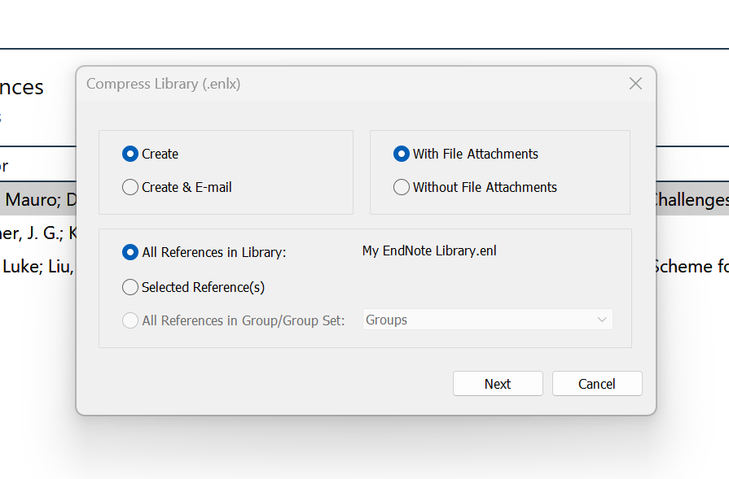
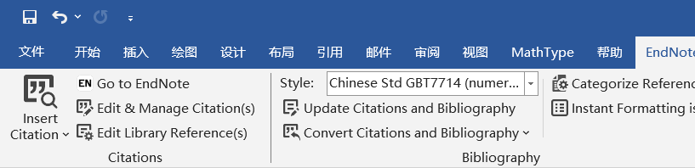
235236 韩永欣
3. Literature Citation
4. Literature Sharing
The need for citation after reading the literature
Generate reference lists automatically
Emphasize collaboration and information dissemination
An advantage of software
Notes:
Literature Citation: Due to the potential need for citation after reading the literature, we chose the function of literature citation. Users can directly generate reference lists in Word or LaTeX using EndNote, and select the appropriate citation format.
Literature Sharing: This section was chosen to emphasize the importance of collaboration and information dissemination in the academic community. Literature sharing enables users to conveniently share the collected literatures with others and it is also an advantage of using electronic literature management software.

Slide 12
PART 03
Article Writing & Design

Slide 13
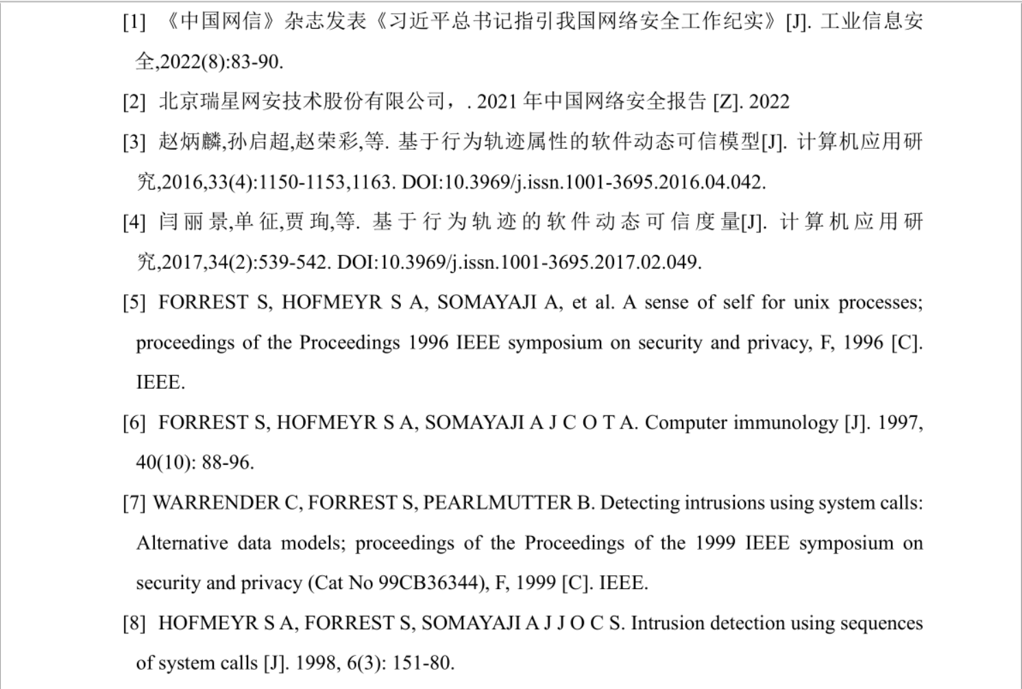




235235 窦艺初
Pre-Research
hands-on
Data Survey
Search
AI study

Slide 14
235238 李婷婷
Support Formats
PubMed, Web of Science, Scopus…
Journal Articles, Books, Patents, Presentations, Theses, Reports…
PDFs, Word documents, image files…
APA, MLA, Chicago, Harvard…
Bibliographic Databases
Document Types
File Formats
Citation Styles

Slide 15
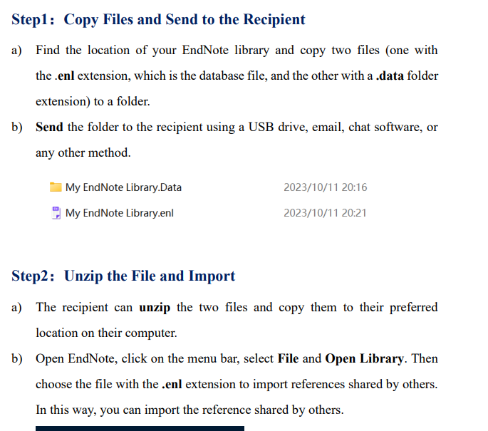
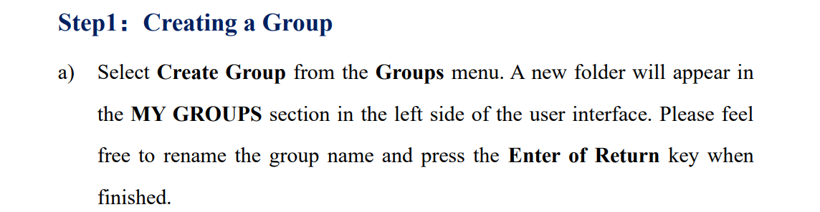
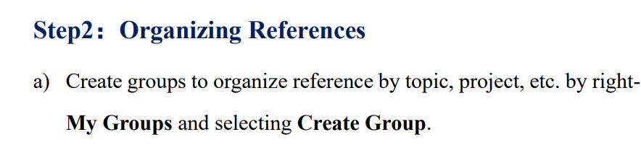
235238 李婷婷
Step-by-step Approach
More detailed
Clear instructions
Boldfaced

Slide 16
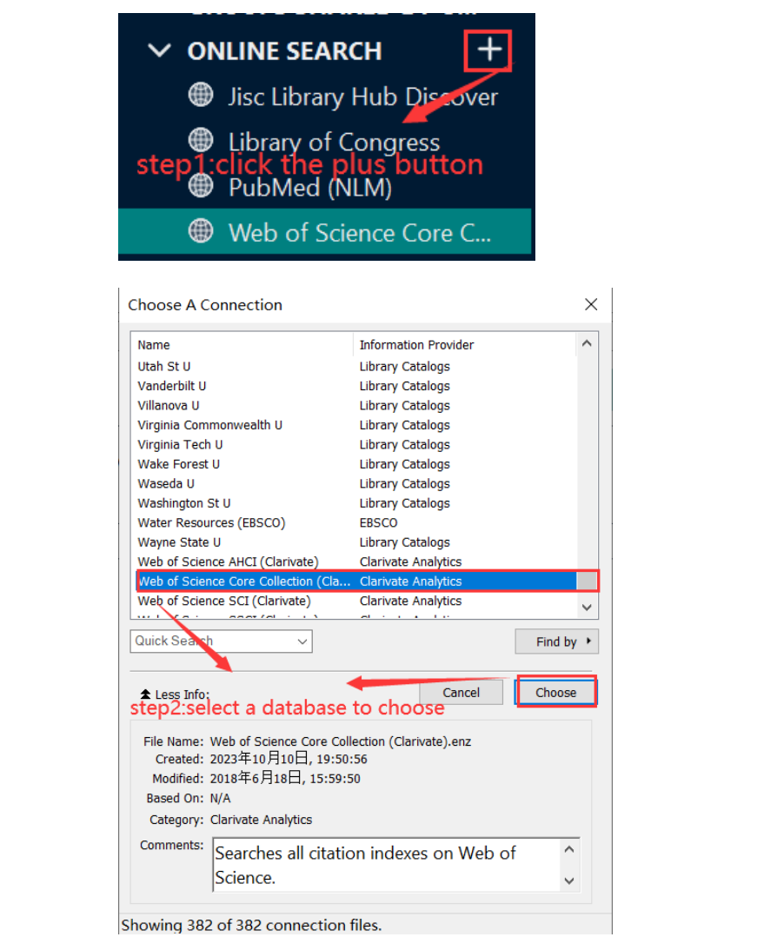
235238 李婷婷
Visual Aid
Rectangle & Arrow
Label with Annotations

Slide 17
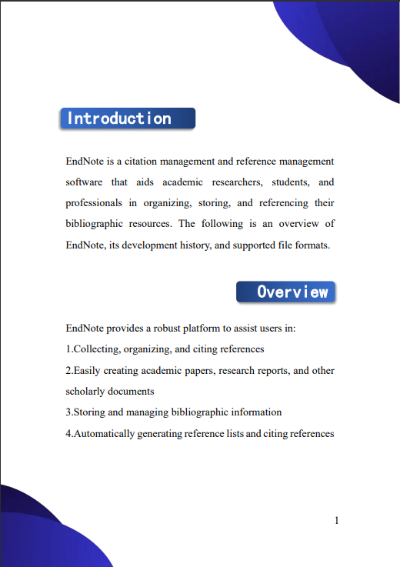
235238 李婷婷
Polish
New cover
New subtitle

Slide 18
235237 孙利峰
Improvements
UI
Functions
Price
Integration
Networks

Slide 19
235237 孙利峰
Chinese-friendly
Chinese Character Support
Chinese UI
Translation
Chinese Literature Types
Chinese Styles
Chinese Search
Chinese Database Support
Database
Citation

Slide 20
PART 04
Summary
Notes:
Thank you for your time. Today we mainly introduced our work on the user manual of endnote. And finally, let me give a our work.

Slide 21
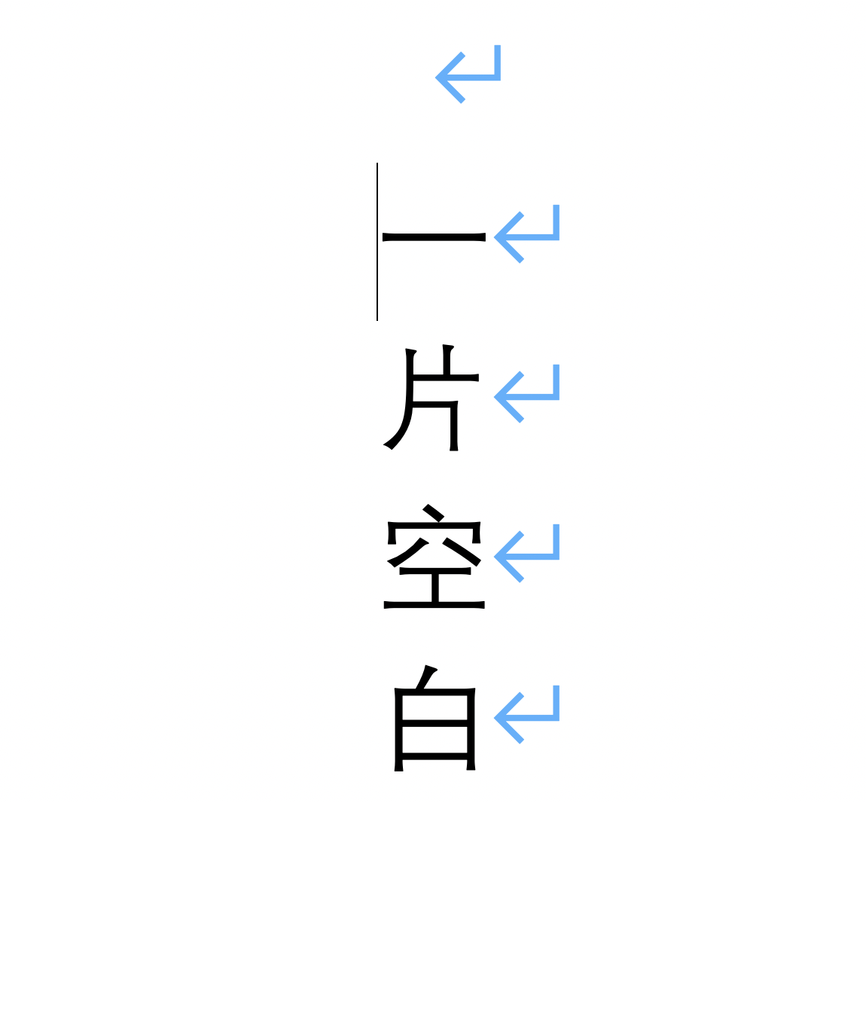
235233 金子昂
Summary
Design Concept
Comprehensive
User-friendly
Concise
Notes:
First, we chose endnote as our target, out of it’s great ability of reference management. As a user manual, we thought it should have Some specific qualities. That's why we've established three basic design principles, which are user-friendly, comprehensive and concise.

Slide 22
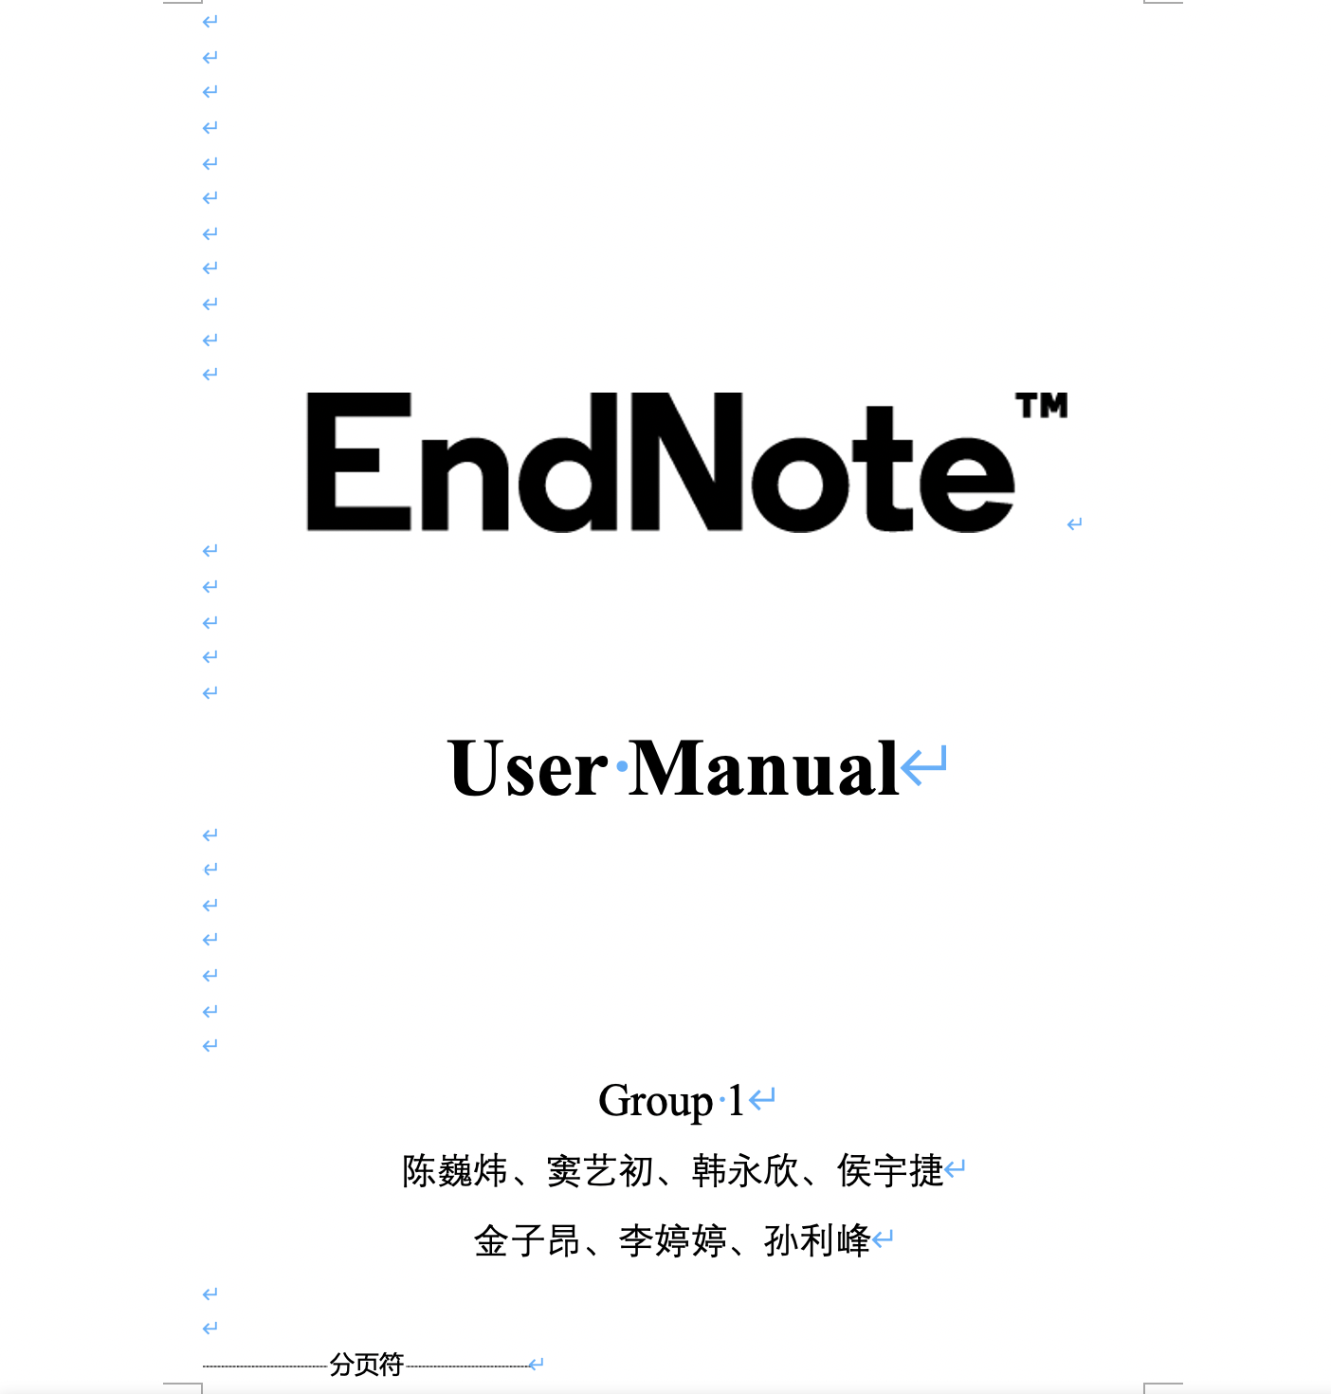
235233 金子昂
Summary
Job assignment
Pre- Research
Hands-on operation
Writing
…
Hard work
First draft!
Notes:
After we made the baseline, We assign the tasks properly. And every group member a

Slide 23

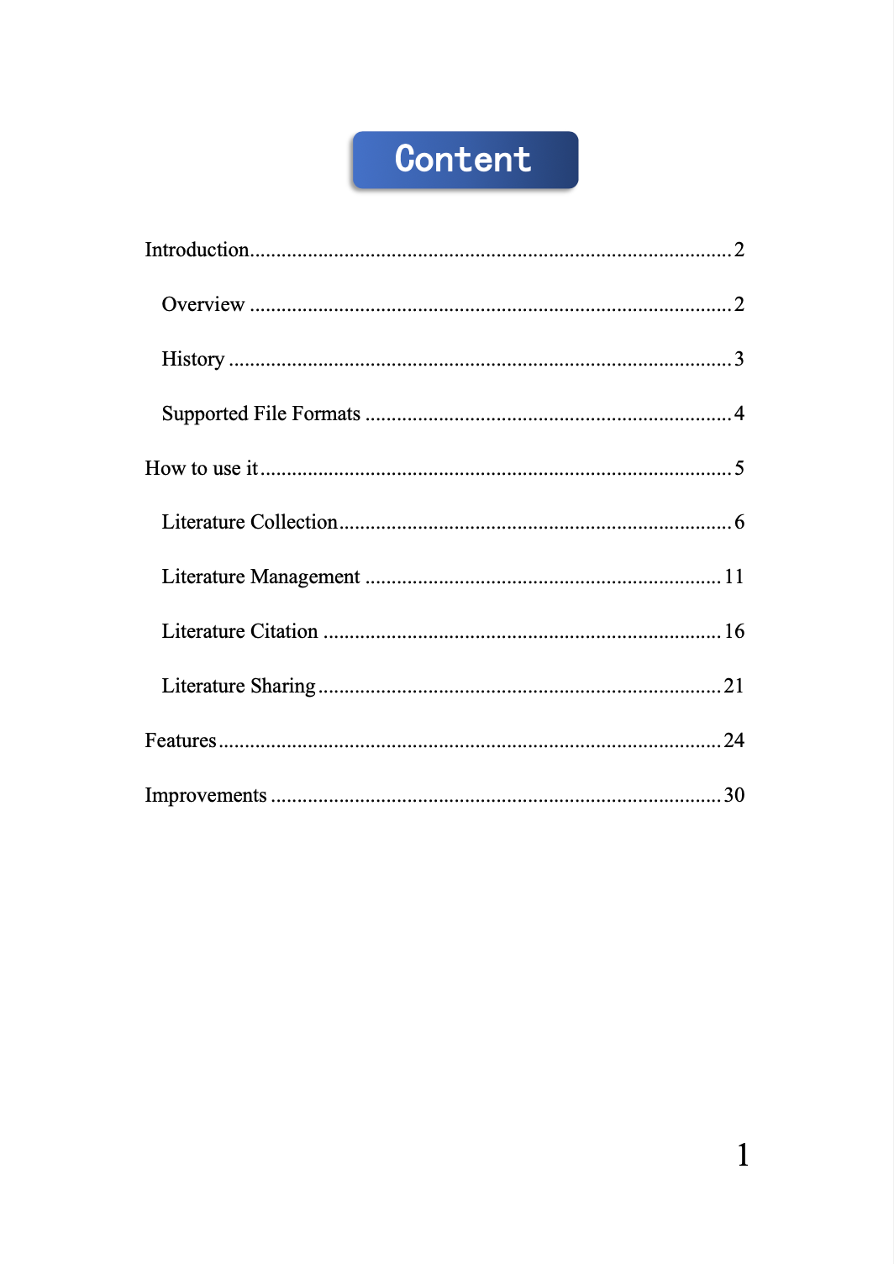


235233 金子昂
Summary
brainstorm
Background
Colors
Graphic design
…
polish
Final draft!
Notes:
Finally， let’s give a brief summary about our work. First, we chose endnote as our target. Then, we divided the work into three main parts and distributed the work reasonably. After a period of hard work, we achieved preliminary results. But we were not satisfied with it. After redesigning and adjusting, we got the final result.

Slide 24

235233 金子昂
Summary
What did we get ?
Teamwork experience
How to use Endnote
How to design a user manual
Notes:
Finally， let’s give a brief summary about our work. First, we chose endnote as our target. Then, we divided the work into three main parts and distributed the work reasonably. After a period of hard work, we achieved preliminary results. But we were not satisfied with it. After redesigning and adjusting, we got the final result.

Slide 25

235233 金子昂
Summary
Have we been perfect ?
Inconsistent image size
No consideration for the visually impaired
Notes:
Finally， let’s give a brief summary about our work. First, we chose endnote as our target. Then, we divided the work into three main parts and distributed the work reasonably. After a period of hard work, we achieved preliminary results. But we were not satisfied with it. After redesigning and adjusting, we got the final result.

Slide 26
EndNote
感谢观看与指导
汇报人：Group1

